Slide 1
F# Succinct, Expressive, Functional
The F# Team
Microsoft Developer Division
Microsoft Research

Slide 2
Topics
What is F# about?
Some Simple F# Programming
A Taste of Parallel/Reactive with F#

Slide 3
What is F# about?
Or: Why is Microsoft investing in functional programming anyway?

Slide 4
Simplicity

Slide 5
Economics

Slide 6
Programmer Productivity

Slide 7
Simplicity

Slide 8


Slide 9
Code!
//F#
open System
let a = 2
Console.WriteLine a
//C#
using System;
namespace ConsoleApplication1
{
class Program
{
static int a()
{
return 2;
}
static void Main(string[] args)
{
Console.WriteLine(a);
}
}
}
More Noise
Than Signal!

Slide 10
Pleasure
Pain
type Command = Command of (Rover -> unit)
let BreakCommand =
Command(fun rover -> rover.Accelerate(-1.0))
let TurnLeftCommand =
Command(fun rover -> rover.Rotate(-5.0<degs>))
abstract class Command
{
public virtual void Execute();
}
abstract class MarsRoverCommand : Command
{
protected MarsRover Rover { get; private set; }
public MarsRoverCommand(MarsRover rover)
{
this.Rover = rover;
}
}
class BreakCommand : MarsRoverCommand
{
public BreakCommand(MarsRover rover)
: base(rover)
{
}
public override void Execute()
{
Rover.Rotate(-5.0);
}
}
class TurnLeftCommand : MarsRoverCommand
{
public TurnLeftCommand(MarsRover rover)
: base(rover)
{
}
public override void Execute()
{
Rover.Rotate(-5.0);
}
}

Slide 11
Pleasure
Pain
type Expr =
| True
| And of Expr * Expr
| Nand of Expr * Expr
| Or of Expr * Expr
| Xor of Expr * Expr
| Not of Expr
public abstract class Expr { }
public abstract class UnaryOp :Expr
{
public Expr First { get; private set; }
public UnaryOp(Expr first)
{
this.First = first;
}
}
public abstract class BinExpr : Expr
{
public Expr First { get; private set; }
public Expr Second { get; private set; }
public BinExpr(Expr first, Expr second)
{
this.First = first;
this.Second = second;
}
}
public class TrueExpr : Expr { }
public class And : BinExpr
{
public And(Expr first, Expr second) : base(first, second) { }
}
public class Nand : BinExpr
{
public Nand(Expr first, Expr second) : base(first, second) { }
}
public class Or : BinExpr
{
public Or(Expr first, Expr second) : base(first, second) { }
}
public class Xor : BinExpr
{
public Xor(Expr first, Expr second) : base(first, second) { }
}
public class Not : UnaryOp
{
public Not(Expr first) : base(first) { }
}
http://stepheneasey.wordpress.com/tag/c/

Slide 12
Pleasure
Pain
let rotate (x,y,z) = (z,x,y)
let reduce f (x,y,z) =
f x + f y + f z
Tuple<V,T,U> Rotate(Tuple<T,U,V> t)
{
return new Tuple<V,T,U>(t.Item3,t.Item1,t.Item2);
}
int Reduce(Func<T,int> f,Tuple<T,T,T> t)
{
return f(t.Item1) + f(t.Item2) + f (t.Item3);
}

Slide 13
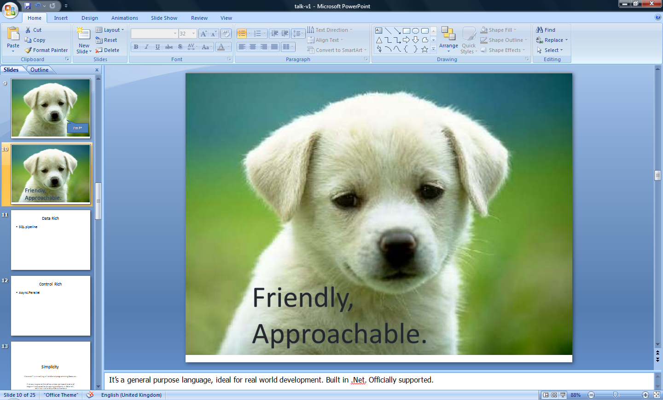


Slide 14
You
Can
Interoperate
With
Everything

Slide 15
Everything
Can
Interoperate
With
You

Slide 16
Economics

Slide 17
Programmer Productivity

Slide 18
People
Love
Programming
In
F#

Slide 19
F#: Influences
OCaml
C#/.NET
F#
Similar core
language
Similar object
model

Slide 20
F#: Combining Paradigms
I've been coding in F# lately, for a production task. F# allows you to move smoothly in your programming style... I start with pure functional code, shift slightly towards an object-oriented style, and in production code, I sometimes have to do some imperative programming.
I can start with a pure idea, and still finish my project with realistic code. You're never disappointed in any phase of the project!
Julien Laugel, Chief Software Architect, www.eurostocks.com

Slide 21
F#: The Combination Counts!
Statically Typed
Succinct
F#
Libraries
Explorative
Interoperable
Efficient
Scalable

Slide 22
F# in More Detail

Slide 23
Functional Core
Objects
Units of Measure
Imperative Mutation & I/O
Computation Expressions
Meta Programming
Functional Data

Slide 24
Quick Tour
Comments
// comment
(* comment *)
/// XML doc comment
let x = 1

Slide 25
Quick Tour
Overloaded Arithmetic
x + y Addition
x - y Subtraction
x * y Multiplication
x / y Division
x % y Remainder/modulus
-x Unary negation
Booleans
not expr Boolean negation
expr && expr Boolean “and”
expr || expr Boolean “or”

Slide 26
Orthogonal & Unified Constructs
Type inference. The safety of C# with the succinctness of a scripting language
Let “let” simplify your life…
Bind a static value
let data = (1,2,3)
let f(a,b,c) =
let sum = a + b + c
let g(x) = sum + x*x
g(a), g(b), g(c)
Bind a static function
Bind a local value
Bind a local function

Slide 27
Demo: Let’s WebCrawl…

Slide 28
Orthogonal & Unified Constructs
Functions: like delegates + unified and simple
One simple
mechanism,
many
uses
Anonymous
Function value
(fun x -> x + 1)
let f(x) = x + 1
(f,f)
val f : int -> int
predicate = 'a -> bool
send = 'a -> unit
Declare a
function value
threadStart = unit -> unit
A pair
of function values
comparer = 'a -> 'a -> int
hasher = 'a -> int
A function type
equality = 'a -> 'a -> bool

Slide 29
F# - Functional
let f x = x+1
let pair x = (x,x)
let fst (x,y) = x
let data = (Some [1;2;3], Some [4;5;6])
match data with
| Some(nums1), Some(nums2) -> nums1 @ nums2
| None, Some(nums) -> nums
| Some(nums), None -> nums
| None, None -> failwith "missing!"

Slide 30
F# - Functional
List.map Seq.fold
Array.filter Lazy.force Set.union
Map LazyList Events Async...
[ 0..1000 ]
[ for x in 0..10 -> (x, x * x) ]
[| for x in 0..10 -> (x, x * x) |]
seq { for x in 0..10 -> (x, x * x) }
Range
Expressions
List via query
Array via query
IEnumerable
via query

Slide 31
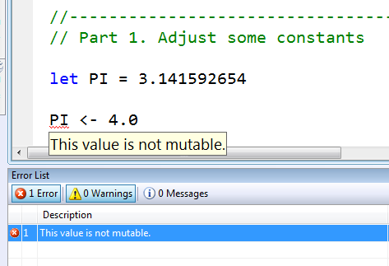
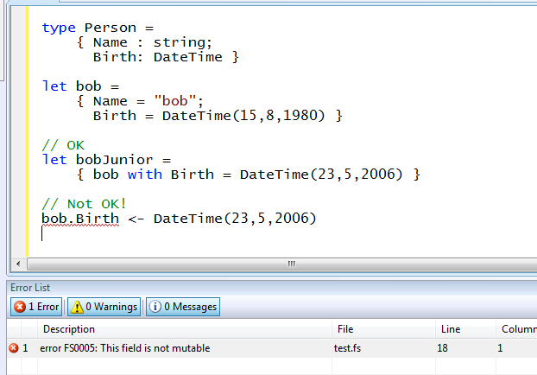
Immutability the norm…
Data is immutable by default
Values may not be changed
✓ Copy & Update
✗ Not Mutate

Slide 32
In Praise of Immutability
Immutable objects can be relied upon
Immutable objects can transfer between threads
Immutable objects can be aliased safely
Immutable objects lead to (different) optimization opportunities

Slide 33
F# - Lists
Generated Lists
open System.IO
let rec allFiles(dir) =
[ for file in Directory.GetFiles(dir) do
yield file
for sub in Directory.GetDirectories(dir) do
yield! allFiles(sub) ]
allFiles(@"C:\Demo")

Slide 34
F# - Sequences
On-demand sequences
open System.IO
let rec allFiles(dir) =
seq
{ for file in Directory.GetFiles(dir) do
yield file
for sub in Directory.GetDirectories(dir) do
yield! allFiles(sub) }
allFiles(@"C:\WINDOWS")
|> Seq.take 100
|> show
Pipelines

Slide 35
Weakly Typed? Slow?
//F#
#light
open System
let a = 2
Console.WriteLine(a)
//C#
using System;
namespace ConsoleApplication1
{
class Program
{
static int a()
{
return 2;
}
static void Main(string[] args)
{
Console.WriteLine(a);
}
}
}
Looks Weakly typed?
Maybe Dynamic?
Notes:
But why does F# omit any type information? Is it not type safe? Is it coercive maybe? Or weakly typed? Maybe this is one of those dynamic languages I read about at 37 signals?

Slide 36
Typed
Untyped
Efficient
Interpreted
Reflection Invoke
F#
Yet rich, dynamic
Yet succinct
Notes:
But it has some features to make this a little more comfortable. We’ll see a bit of that later.

Slide 37
Objects
Class Types
type ObjectType(args) =
let internalValue = expr
let internalFunction args = expr
let mutable internalState = expr
member x.Prop1 = expr
member x.Meth2 args = expr
Constructing Objects
new FileInfo(@"c:\misc\test.fs")

Slide 38
F# - Objects + Functional
type Vector2D(dx:double,dy:double) =
member v.DX = dx
member v.DY = dy
member v.Length = sqrt(dx*dx+dy*dy)
member v.Scale(k) = Vector2D(dx*k,dy*k)
Inputs to object construction
Exported properties
Exported method

Slide 39
F# - Objects + Functional
type Vector2D(dx:double,dy:double) =
let norm2 = dx*dx+dy*dy
member v.DX = dx
member v.DY = dy
member v.Length = sqrt(norm2)
member v.Norm2 = norm2
Internal (pre-computed) values and functions

Slide 40
F# - Objects + Functional
Immutable inputs
type HuffmanEncoding(freq:seq<char*int>) =
...
< 50 lines of beautiful functional code>
...
member x.Encode(input: seq<char>) =
encode(input)
member x.Decode(input: seq<char>) =
decode(input)
Internal tables
Publish access

Slide 41
F# - Objects + Functional
type Vector2D(dx:double,dy:double) =
let mutable currDX = dx
let mutable currDX = dy
member v.DX = currDX
member v.DY = currDY
member v.Move(x,y) =
currDX <- currDX+x
currDY <- currDY+y
Internal state
Publish internal state
Mutate internal state

Slide 42
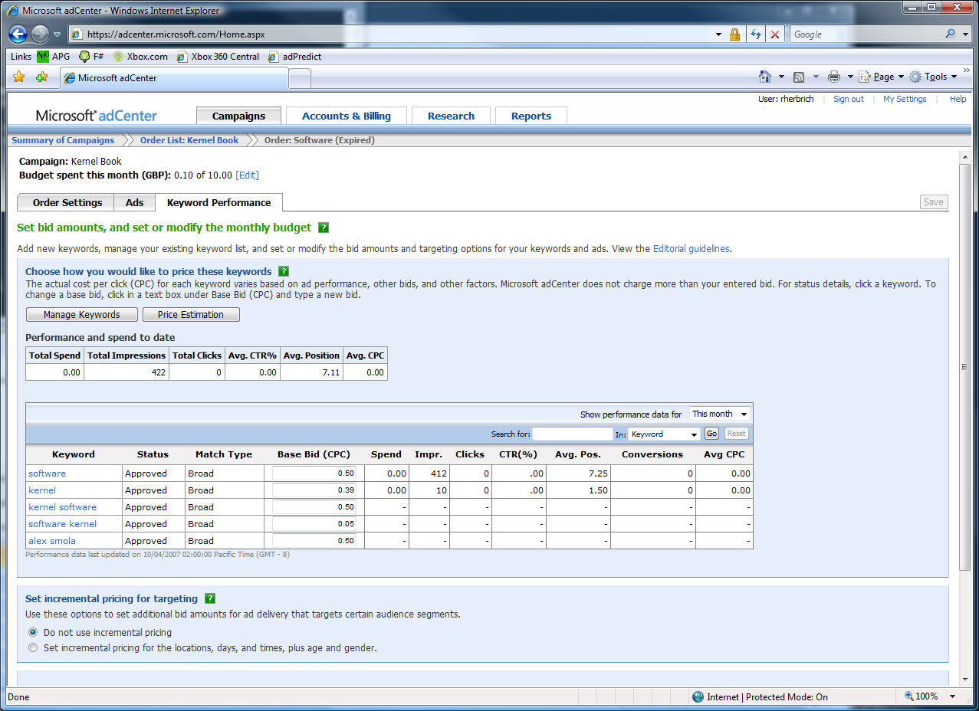

The adCenter Problem

Slide 43
The Scale of Things
Weeks of data in training:
N,000,000,000 impressions, 6TB data
2 weeks of CPU time during training:
2 wks × 7 days × 86,400 sec/day =
1,209,600 seconds
Learning algorithm speed requirement:
N,000 impression updates / sec
N00.0 μs per impression update

Slide 44
F# and adCenter
4 week project, 4 machine learning experts
100million probabilistic variables
Processes 6TB of training data
Real time processing

Slide 45
AdPredict: What We Observed
F#’s powerful type inference means less typing, more thinking
Type-inferred code is easily refactored
Quick Coding
Agile Coding
Scripting
Performance
Memory-Faithful
Succinct
Symbolic
.NET Integration
“Hands-on” exploration.
Immediate scaling to massive data sets
mega-data structures, 16GB machines
Live in the domain, not the language
Schema compilation and “Schedules”
Especially Excel, SQL Server

Slide 46
Smooth Transitions
Researcher’s Brain → Realistic, Efficient Code
Realistic, Efficient Code → Component
Component → Deployment

Slide 47
F# Async/Parallel

Slide 48
async { ... }
A Building Block for Async/Parallel/Reactive Design Patterns
async { ... }
For users:
You can run it, but it may take a while
Or, your builder says...
OK, I can do the job, but I might have to talk to someone else about it. I’ll get back to you when I’m done

Slide 49
Demo

Slide 50
The F# Approach
In parallel programming,
F# is a power tool
for good architects and good developers
Good Architecture
Know your techniques
Know your requirements
Know your limits (CPU, disk, network, latency)
Translate Good Architecture into Good Code with F#
A great platform
A massive increase in isolation and immutability
A massive reduction in mutation

Slide 51
async { ... }
Asynchronous "non-blocking" action
async { let! image = ReadAsync "cat.jpg"
let image2 = f image
do! writeAsync image2 "dog.jpg"
do printfn "done!"
return image2 }
Continuation/
Event callback
You're actually writing this (approximately):
async.Delay(fun () ->
async.Bind(ReadAsync "cat.jpg", (fun image ->
let image2 = f image
async.Bind(writeAsync "dog.jpg",(fun () ->
printfn "done!"
async.Return())))))

Slide 52
async { ... }
Asynchronous "non-blocking" action
async { let! image = ReadAsync "cat.jpg"
let image2 = f image
do! writeAsync image2 "dog.jpg"
do printfn "done!"
return image2 }
Continuation/
Event callback
You're actually writing this (approximately):
async.Delay(fun () ->
async.Bind(ReadAsync "cat.jpg", (fun image ->
let image2 = f image
async.Bind(writeAsync "dog.jpg",(fun () ->
printfn "done!"
async.Return())))))

Slide 53
async { ... }
Built on a much more general mechanism called “computation expressions”
seq { ... } (queries/sequences)
eventStream { ... } (queries over event streams)
parser { ... } (parser combinators)
resumable { ... } (resumptions)

Slide 54
Demo

Slide 55
8 Ways to Learn
FSI.exe
Samples Included
Go to definition
Lutz’ Reflector
http://cs.hubfs.net
Codeplex Fsharp Samples
Books
ML

Slide 56
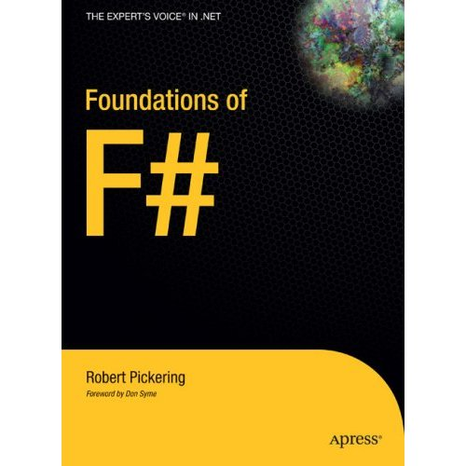
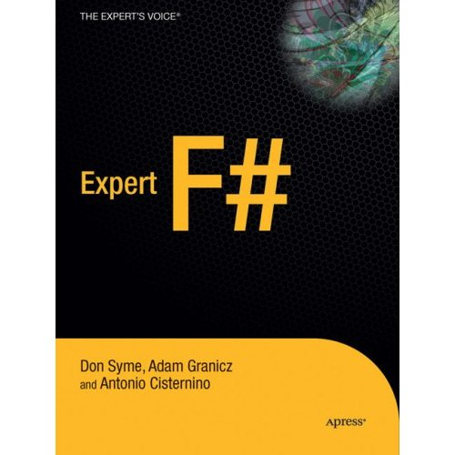
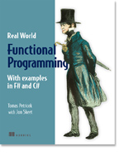

Books about F#
Visit www.fsharp.net

Slide 57
Getting F#
September 2008: CTP released
F# will be a supported language in
Visual Studio 2010
Next stop: Visual Studio 2010 Beta 1
Look for it soon!

Slide 58
Questions & Discussion

Slide 59



© 2007 Microsoft Corporation. All rights reserved. This presentation is for informational purposes only. MICROSOFT MAKES NO WARRANTIES, EXPRESS OR IMPLIED, IN THIS SUMMARY.

Slide 60

1985
Mirror on underside of shuttle
SDI experiment: The plan
Big mountain in Hawaii

Slide 61
1985
SDI experiment:
The reality

Slide 62
1985
The reality

Slide 63

NASA Mars Climate Orbiter, 1999

Slide 64
NASA Mars Climate Orbiter, 1999

Slide 65
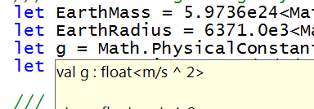
let EarthMass = 5.9736e24<kg>
// Average between pole and equator radii
let EarthRadius = 6371.0e3<m>
// Gravitational acceleration on surface of Earth
let g = PhysicalConstants.G * EarthMass / (EarthRadius * EarthRadius)

